Slide 1
E-Commerce and Internet Marketing
by Dr Aarti Kaushal
Assistant. Professor
GCCBA Sec-42

Slide 2
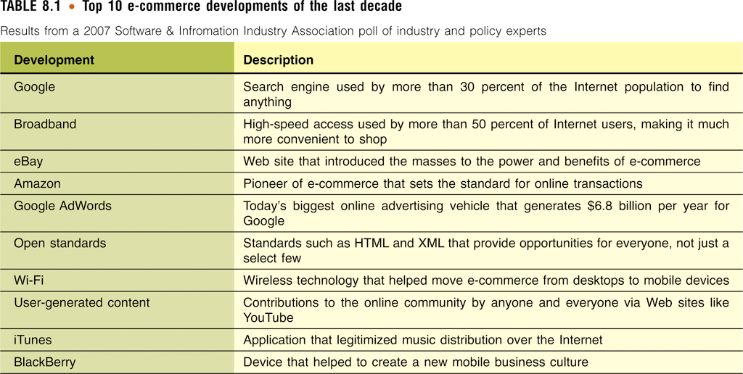
Electronic Commerce
Electronic commerce (e-commerce)

Slide 3
Types of E-Commerce
Business-to-consumer e-commerce (B2C)
  Connects individual consumers with sellers , cutting out the middleman
  E.g. Amazon.com
Business-to-business e-commerce (B2B)
  Supports business transactions on across private networks, the Internet, and the Web
Consumer-to-consumer e-commerce (C2C)
  Connects individual sellers with people shopping for used items
  E.g. www.ebay.com, www.olx.com

Slide 4
E-Commerce from the Buyer’s Perspective
Process of buying or acquiring goods or services
  Realizing a need
  Researching a product
  Selecting a vendor
  Providing payment
  Accepting delivery
  Using product support

Slide 5
E-Commerce from the Seller’s Perspective
Sellers business practices:
  Market research to identify customer needs
  Manufacturing products or supplying services that meet customer needs
  Marketing and advertising to make customers aware of available products and services

Slide 6
Benefits and Challenges of E-Commerce
Buyers enjoy the convenience of shopping from their desktop
B2C e-commerce
  Levels the playing field between large and small businesses
Challenges
  Established businesses must alter systems and business practices
  Security, privacy, reliability: E-commerce can survive only if all involved can trust the system
  Social concerns

Slide 7
E-Commerce Applications
E-Commerce
  Playing an increasingly important role in our personal and professional lives
  Allows us to discover new and interesting products
  Allows us to find better deals
  Used to monitor bank accounts and transfer electronic funds

Slide 8
Retail E-Commerce: Shopping Online
E-tailing provides customers with
  Product information
  The ability to comparison shop
E-tailing options
  Set up an electronic storefront
  Lease space in a cybermall
    Web site that allows users to browse through a wide variety of products offered by several different retailers

Slide 9
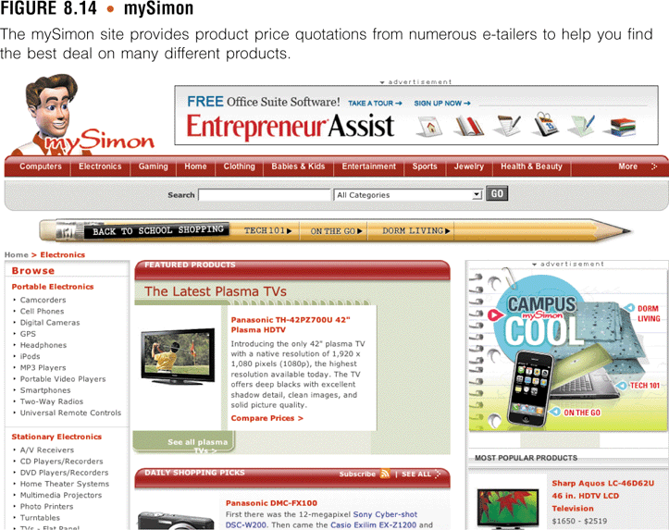
Retail E-Commerce: Shopping Online

Slide 10
Online Clearing Houses, Web Auctions, and Marketplaces
Provide a platform for businesses and individuals to sell their products and belongings
  eBay.com .olx.com
    Most popular auction/marketplace

Slide 11
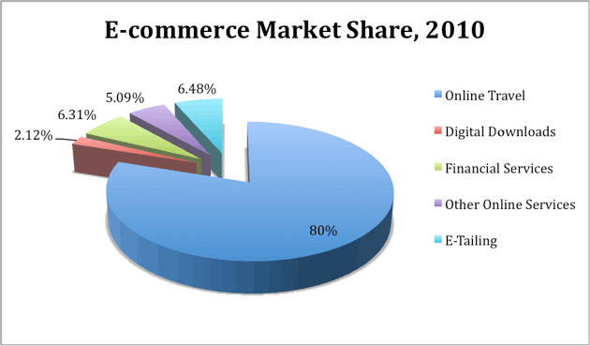

Slide 12
Web is used for
  advertising
    Banner: A rectangular area embedded in the Web page content for advertising, often across the top of the page
    Pop ups: flashing ads that keep coming whenever you are online

Slide 13
M-Commerce Applications
Using mobile technology for m-trade
Methods for delivering m-commerce services
  Directly from cell phone service providers
  Via mobile Internet or Web applications
    Location-based m-commerce applications
  Using Short Message Service (SMS) text messaging or Multimedia Messaging Service (MMS)

Slide 14
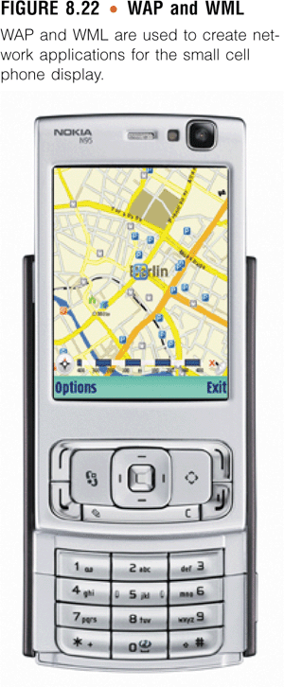
Types of M-Commerce Applications

Slide 15
E-Commerce Implementation
Implementing e-commerce
  Requires large investment and expertise
E-Commerce host
  A company that takes on some or all of the responsibility of setting up and maintaining an e-commerce system for a business or organization

Slide 16
Infrastructure
E-Commerce requires significant infrastructure changes
Businesses must have employees who are technically savy
B2C e-commerce
  Often connects manufacturers directly with consumers, cutting out the middleman
  Requires shipping individual products directly to consumers

Slide 17
Building Traffic
E- Marketing
  Online advertising methods include banner ads, pop-up ads, and e-mail
  market segmentation: customer opinions are divided into demographic variables such as race, gender, income, education, and age to determine which segment a product appeals to most
  Offline advertising methods include magazines, newspapers, radio, and television

Slide 18
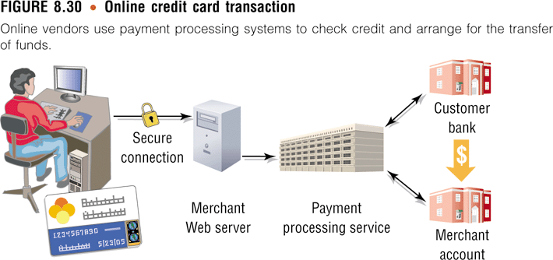
Electronic Payment System

Slide 19
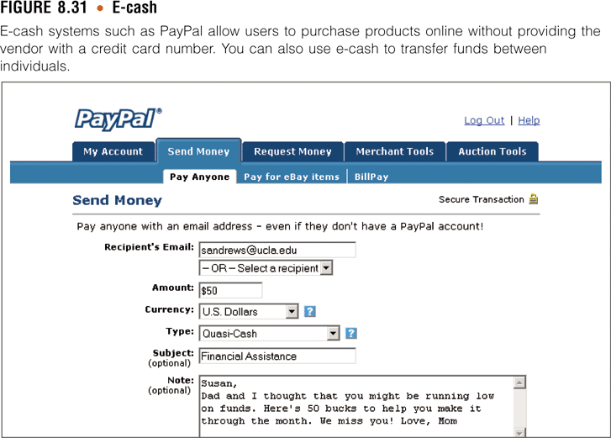
Electronic Payment System

Slide 20
International Markets
Internet users of all nationalities will have access to your products
First consideration of a global e-commerce strategy
  Visitors of all nationalities and cultures should feel comfortable while viewing your Web content
Costly approach
  Create multiple versions of your Web site, each in a different language

Slide 21
E-Commerce Security Issues
Concerns:
There are significant privacy and security concerns
  Public network
  No buyer or seller identity verification
  Hacker attacks

Slide 22
??????????
Retail Web sites
  Allow consumers to comparison shop
Mobile commerce
  A form of e-commerce that takes place over wireless mobile devices
E-Commerce
  Requires investment in networking, hardware, and a wide variety of software
  Requires changes in infrastructure

Slide 23
Impact of ecommerce on business and education
MVH (Australian web based architecture firm)
Web tendering: competition among suppliers, it is fair, transparent and allows buyer to achieve best possible price
Entertainment :DTH services, online recharges(satellite and mobile recharges)
Education : online registration , fee payment,exams, assignments etc
(Symbiosis, IIM’s)
E-tailing: retailers are online now
flipkart jabbong, homeshop18,snapdeal etc.

Slide 24
All brands at mouth watering price discounts, COD and only minimal internet processing fee (groupon)
Online insurance (policybazaar.com)
Travel and tourism online(yatra.com)
Virtual banks and retail stores upcoming
E- grocery stores:( daily/ weekly/ monthly delivery after online request and payment)
Music and video downloads:www.hungama.com, www.cooltoad.com,www.pappuyaar.com,www.songs.pk.com( login required)
Internet gaming, e books , SNW
Event ticketing(concerts, shows, exhibitions,matches etc)
Restaurants/ fast food chain’s online services (pizza hut,domminos etc)

Slide 25
Internet Marketing:

Slide 26
Question
How many of us have used Internet for purchasing a product or service on-line?

Slide 27
Advantages of the
Marketspace
DIRECT CONTACT
HIGH SPEED
GREAT VARIETY
USE OF MULTIMEDIA
ACCESSIBLE 24 HOURS…
…FROM AROUND THE WORLD!!!
LOW COST

Slide 28
Traditional vs. Internet Marketing
Old Media | New Media
Mass marketing | Individualised marketing or mass-customisation
Monologue | Dialogue
Branding | Communication
Supply side thinking | Demand side thinking
Customer as a target | Customer as a partner
Segmentation | Communities

Slide 29
“If I’m selling to you, I speak your language. If I am buying, dann mussen Sie Deutsch sprechen (then you must speak German).”
-Will Brandt, ex-Chancellor, Germany

Slide 30

Social Media
The New Kid on the Block
Why Social Media Matters
Communicate with and gain insights from target customers
Social media provides tremendous reach at a fraction of the cost of traditional marketing methods
Create awareness and buzz around your brand, service, or product
Successful social media marketing campaigns attract links, and as a result, enhance SEO efforts

Slide 31
Problems of Internet Marketing
Transmission time;
Site congestion;
Lack of organisation;
Lack of security;
Global differences;
Customer is in charge;
Time of visit.

Slide 32
Blog marketing
Ease in adding information
Updates on blog automatically conveyed to other websites with a simple feature added to it
i.e. Gccba blog , Being Human blog, Amitabh Bachan blog etc.

Slide 33

Pitfalls of Internet marketing
Traditional vs. Internet Marketing techniques
Bad news travel quickly
Difficulties with identifying the market
Not many words
Not paying attention
Poor structure
Dishonesty
Channel conflict.

Slide 34
Conclusion :
The number of people and companies doing transactions on the Internet is dramatically increasing;
No company should ignore the power of Internet in doing business…
…but doing business in the Marketspace is different from the marketplace;

Slide 35
Conclusion :
So Internet Marketing is here to provide companies with the way to achieve a desired level of customer satisfaction;
Internet Marketing is not a solution by itself. Companies must be creative, innovative and effective enough in order to avoid Internet marketing problems and seize its opportunities.
E commerce and internet marketing introduces,promotes product tells price, discounts , quick delivery, buiids credibility in market,creates additional stream of advertising income and above all take good care of (P1 P2 P3 P4 P5 P6 P7)

Slide 36
THANK YOU

